Slide 1
Discrete Structure Logical Connectives and Laws of Logic
Week 2
By
Dr. Rafiullah Khan

Slide 2
Truth Table
Make a truth table for the following statements:
1. ~ p ∧ q
2. ~ p ∧ (q ∨ ~ r)
3. (p∨q) ∧ ~ (p∧q)

Slide 3
Truth table for ~ p ∧ q
p
q
~p
~ p ∧ q
T
T
F
F
T
F
F
F
F
T
T
T
F
F
T
F

Slide 4
Truth table for ~ p ∧ (q ∨ ~ r)
p
q
r
~ r
q ∨ ~ r
~ p
~ p ∧ (q ∨ ~ r)
T
T
T
F
T
F
F
T
T
F
T
T
F
F
T
F
T
F
F
F
F
T
F
F
T
T
F
F
F
T
T
F
T
T
T
F
T
F
T
T
T
T
F
F
T
F
F
T
F
F
F
F
T
T
T
T

Slide 5
Truth table for (p∨q) ∧ ~ (p∧q)
p
q
p∨q
p∧q
~ (p∧q)
(p∨q) ∧ ~ (p∧q)
T
T
T
T
F
F
T
F
T
F
T
T
F
T
T
F
T
T
F
F
F
F
T
F

Slide 6
Double Negative Property ~(~p) ≡ p
p
~p
~(~p)
T
F
T
F
T
F
Example
“It is not true that I am not happy”
Solution:
Let p = “I am happy”
then ~ p = “I am not happy”
and ~(~ p) = “It is not true that I am not happy”
Since ~ (~p) ≡ p
Hence the given statement is equivalent to:
“I am happy”

Slide 7
Find out:
~ (p∧q) and ~p ∧ ~q are not logically equivalent or not?
(Hint: Use Truth Table)

Slide 8
~ (p∧q) and ~p ∧ ~q are not logically equivalent
p
q
~p
~q
p∧q
~(p∧q)
~p ∧ ~q
T
T
F
F
T
F
F
T
F
F
T
F
T
F
F
T
T
F
F
T
F
F
F
T
T
F
T
T

Slide 9
TAUTOLOGY
A tautology is a statement form that is always true, regardless of the truth values of the statement variables.
A tautology is represented by the symbol “T”..
EXAMPLE: The statement form p ∨ ~ p is a tautology.
p ∨ ~p ≡ t
p | ~p | p v ~p
T | F | T
F | T | T

Slide 10
CONTRADICTION
A contradiction is a statement form that is always false regardless of the truth values of the statement variables.
A contradiction is represented by the symbol “c”.
EXAMPLE: The statement form p ∧ ~ p is a contradiction
p ∧ ~p ≡ c
p | ~p | p ∧ ~p
T | F | F
F | T | F

Slide 11
EXERCISE:
Use truth table to show that
(p ∧ q) ∨(~p ∨(p ∧ ~q)) is a tautology.

Slide 12
(p ∧ q) ∨(~p ∨(p ∧ ~q)) is a tautology
p | q | p ∧ q | ~ p | ~ q | p ∧ ~ q | ~ p∨ (p ∧ ~q) | (p ∧ q) ∨ (~p ∨ (p ∧ ~q))
T | T | T | F | F | F | F | T
T | F | F | F | T | T | T | T
F | T | F | T | F | F | T | T
F | F | F | T | T | F | T | T

Slide 13
EXERCISE:
Use truth table to show that
(p ∧ ~q) ∧(~p∨q) is a contradiction.

Slide 14
(p ∧ ~q) ∧(~p∨q) is a contradiction
p | q | ~q | p∧~q | ~p | ~p∨q | (p ∧ ~q) ∧(~p∨q)
T | T | F | F | F | T | F
T | F | T | T | F | F | F
F | T | F | F | T | T | F
F | F | T | F | T | T | F

Slide 15
EXCLUSIVE OR
USAGE OF “OR” IN ENGLISH
Inclusive Sense
In English language the word or is sometimes used in an inclusive sense (p or q or both).
Example: I shall buy a pen or a book.
In the above statement, if you buy a pen or a book in both cases the statement is true and if you buy (both) pen and book then statement is again true. Thus we say in the above statement we use or in an inclusive sense.
Exclusive Sense
The word or is sometimes used in an exclusive sense (p or q but not both). As in the below statement
Example: Tomorrow at 9, I’ll be in Lahore or Islamabad.
Now in above statement we are using or in an exclusive sense because both the statements are true then we have F for the statement.
While defining a disjunction the word or is used in its inclusive sense. Thus the symbol ∨ means the “inclusive or”

Slide 16
EXCLUSIVE OR (XOR)
When or is used in its exclusive sense, the statement “p or q” means “p or q but not both” or “p or q and not p and q” which translates into symbols as:
(p ∨ q) ∧ ~ (p ∧ q)
Which is abbreviated as:
p ⊕ q
or p XOR q

Slide 17
TRUTH TABLE FOR EXCLUSIVE OR
p | q | p∨q | p∧q | ~ (p∧q) | (p∨q) ∧ ~ (p∧q)
T | T | T | T | F | F
T | F | T | F | T | T
F | T | T | F | T | T
F | F | F | F | T | F
Note:
Basically
p ⊕ q ≡ (p ∧ ∼q) ∨ (~p ∧ q)
≡ [p ∧ ~q) ∨ ~p] ∧ [(p ∧ ~q) ∨ q]
≡ (p ∨ q) ∧ ∼(p ∧ q)
≡ (p ∨ q) ∧ (∼p ∨ ~q)

Slide 18
Introduction to Laws of Logic
Definition: Laws of logic are foundational principles that guide the process of reasoning. They form the basis of valid inference and correct argumentation.
Importance: Understanding these laws is essential in fields like mathematics, computer science, philosophy, and artificial intelligence.
Main Laws of Logic:
Law of Identity
Law of Non-Contradiction
Law of the Excluded Middle
Law of Double Negation

Slide 19
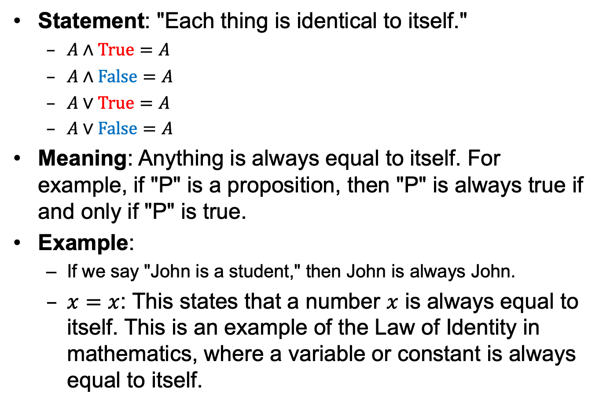
Law of Identity
Statement: "Each thing is identical to itself."
$A∧True=A$
$A∧False=A$
$A∨True=A$
$A∨False=A$
Meaning: Anything is always equal to itself. For example, if "P" is a proposition, then "P" is always true if and only if "P" is true.
Example:
If we say "John is a student," then John is always John.
$x=x$: This states that a number $x$ is always equal to itself. This is an example of the Law of Identity in mathematics, where a variable or constant is always equal to itself.

Slide 20
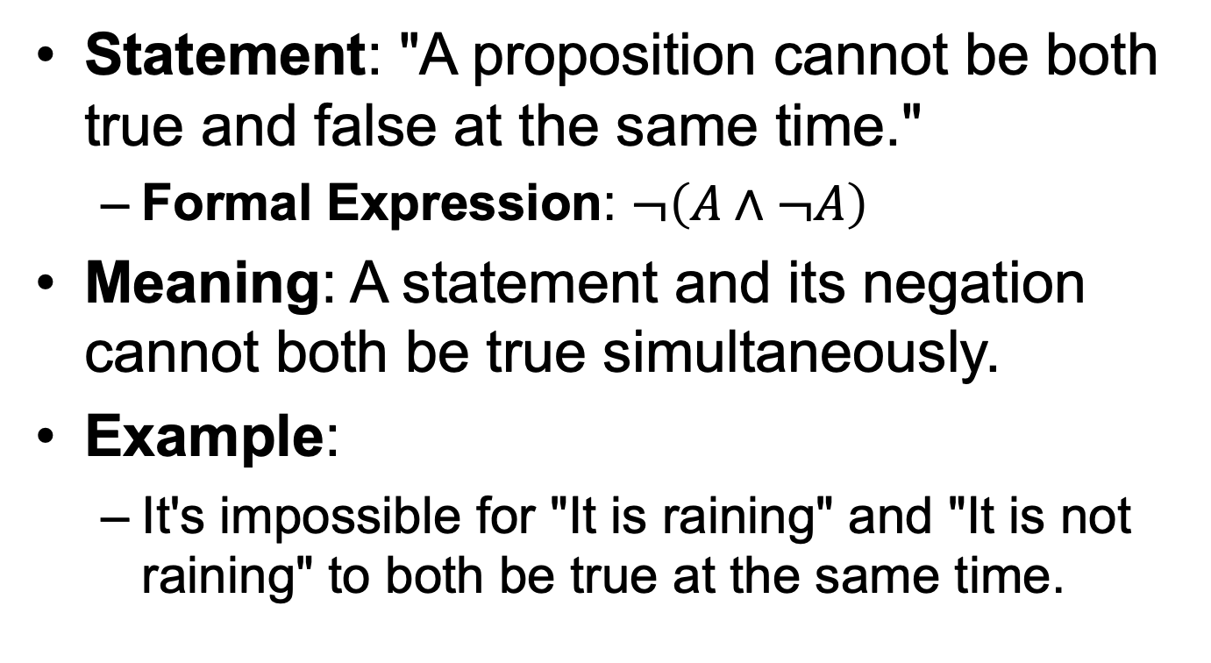
Law of Non-Contradiction
Statement: "A proposition cannot be both true and false at the same time."
Formal Expression: $¬\left(A∧¬A\right)$
Meaning: A statement and its negation cannot both be true simultaneously.
Example:
It's impossible for "It is raining" and "It is not raining" to both be true at the same time.

Slide 21
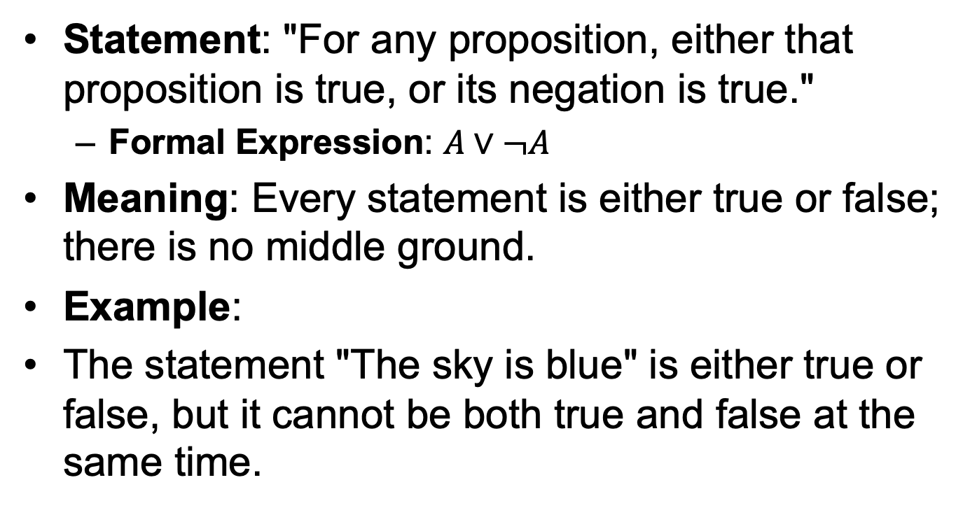
Law of the Excluded Middle
Statement: "For any proposition, either that proposition is true, or its negation is true."
Formal Expression: $A∨¬A$
Meaning: Every statement is either true or false; there is no middle ground.
Example:
The statement "The sky is blue" is either true or false, but it cannot be both true and false at the same time.

Slide 22
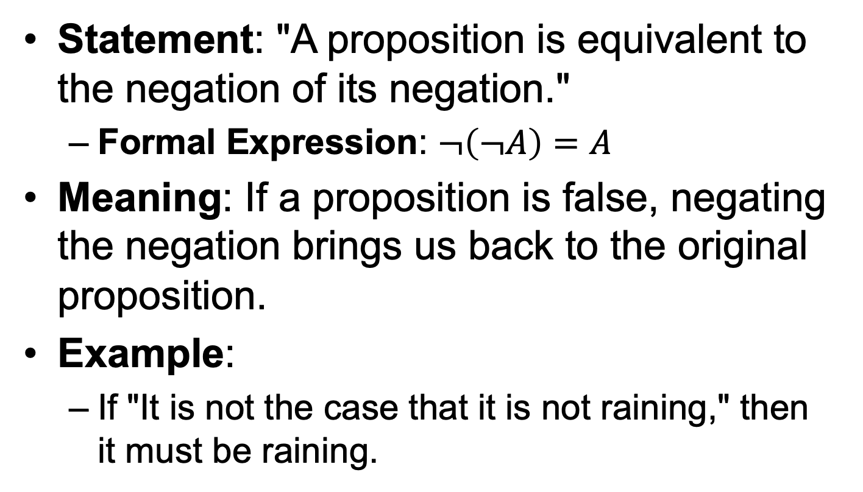
Law of Double Negation
Statement: "A proposition is equivalent to the negation of its negation."
Formal Expression: $¬\left(¬A\right)=A$
Meaning: If a proposition is false, negating the negation brings us back to the original proposition.
Example:
If "It is not the case that it is not raining," then it must be raining.

Slide 23
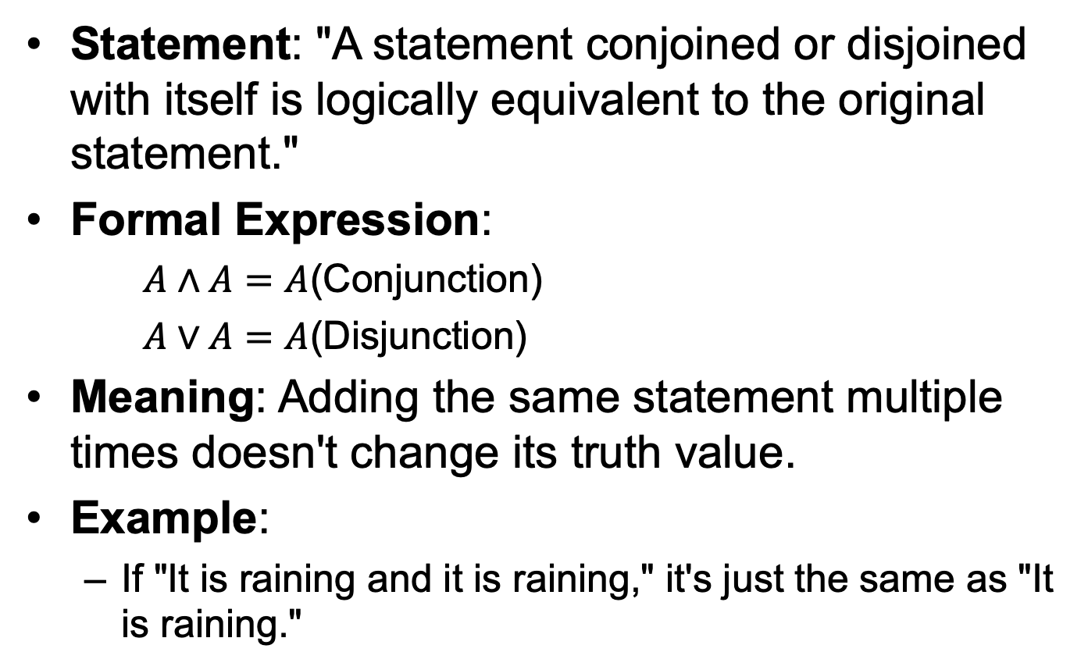
Law of Idempotence
Statement: "A statement conjoined or disjoined with itself is logically equivalent to the original statement."
Formal Expression:
$A∧A=A$(Conjunction)
$A∨A=A$(Disjunction)
Meaning: Adding the same statement multiple times doesn't change its truth value.
Example:
If "It is raining and it is raining," it's just the same as "It is raining."

Slide 24
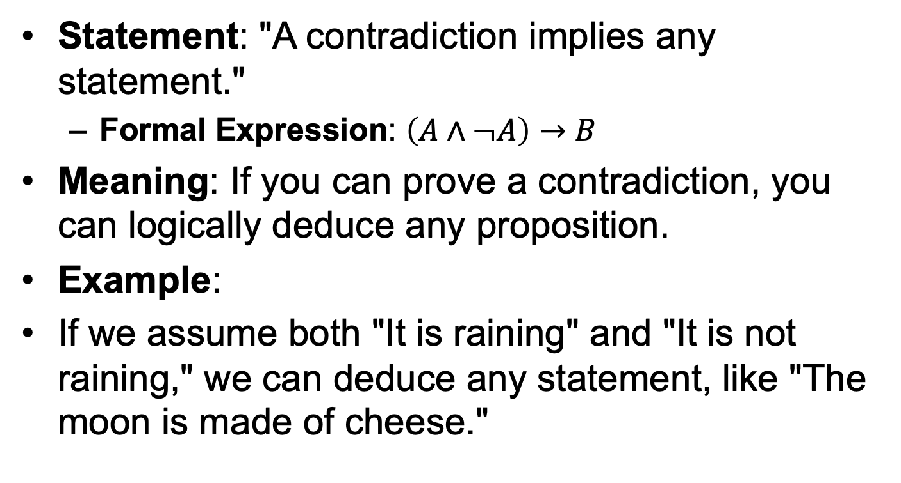
Law of Contradiction
Statement: "A contradiction implies any statement."
Formal Expression: $\left(A∧¬A\right)→B$
Meaning: If you can prove a contradiction, you can logically deduce any proposition.
Example:
If we assume both "It is raining" and "It is not raining," we can deduce any statement, like "The moon is made of cheese."

Slide 25
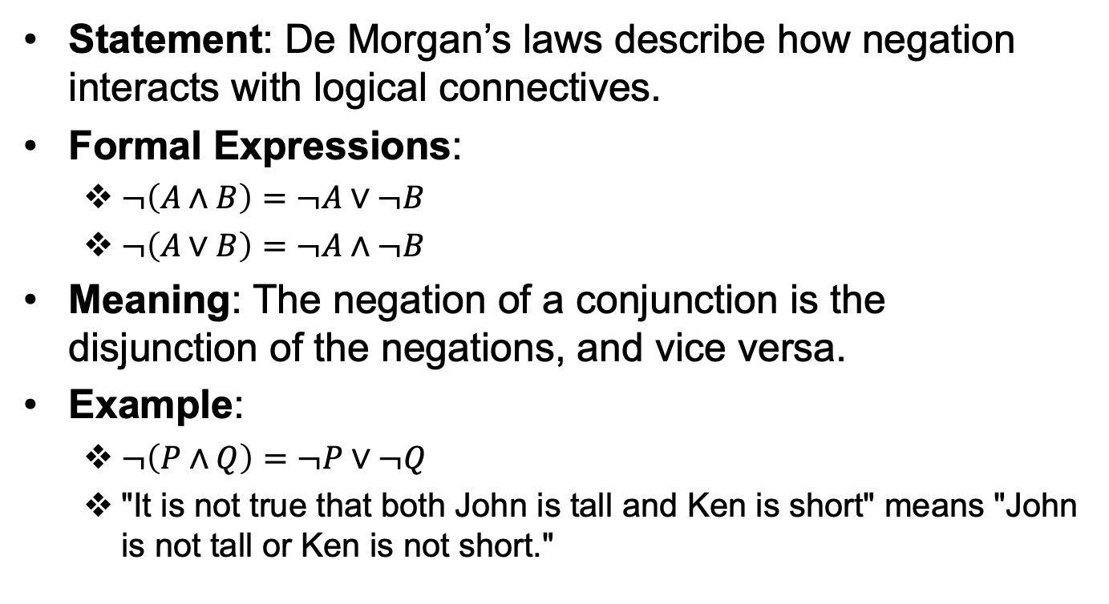
De Morgan’s Laws
Statement: De Morgan’s laws describe how negation interacts with logical connectives.
Formal Expressions:
$¬\left(A∧B\right)=¬A∨¬B$
$¬\left(A∨B\right)=¬A∧¬B$
Meaning: The negation of a conjunction is the disjunction of the negations, and vice versa.
Example:
$¬\left(P∧Q\right)=¬P∨¬Q$
"It is not true that both John is tall and Ken is short" means "John is not tall or Ken is not short."

Slide 26
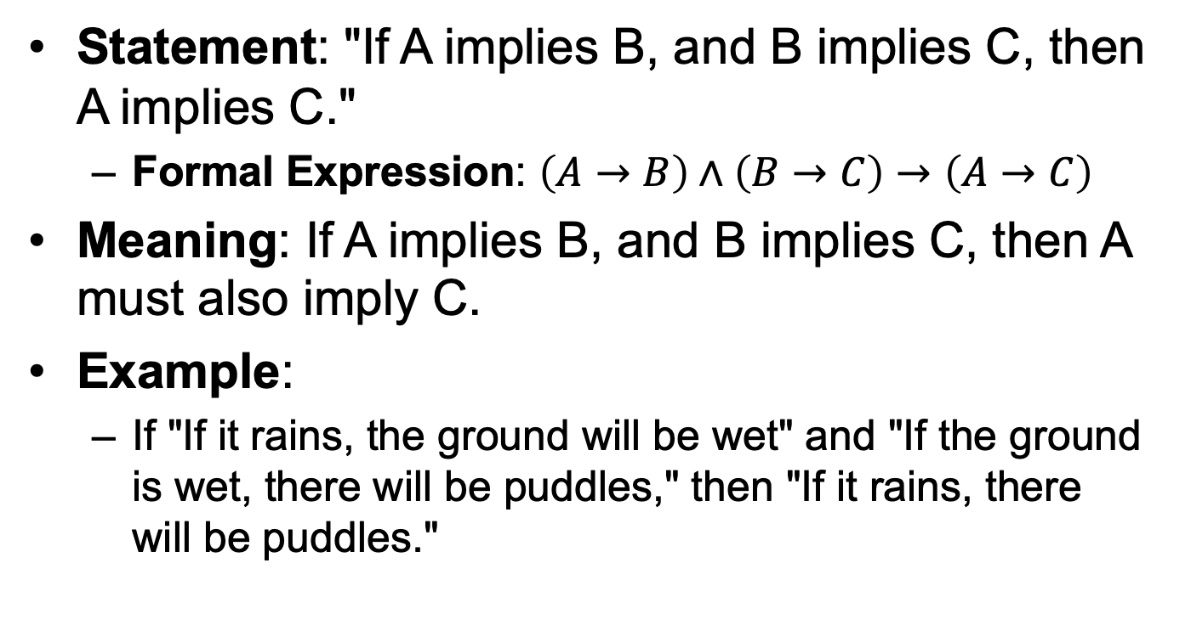
Law of Implication (Transitivity of Implication)
Statement: "If A implies B, and B implies C, then A implies C."
Formal Expression: $\left(A→B\right)∧\left(B→C\right)→\left(A→C\right)$
Meaning: If A implies B, and B implies C, then A must also imply C.
Example:
If "If it rains, the ground will be wet" and "If the ground is wet, there will be puddles," then "If it rains, there will be puddles."

Slide 27
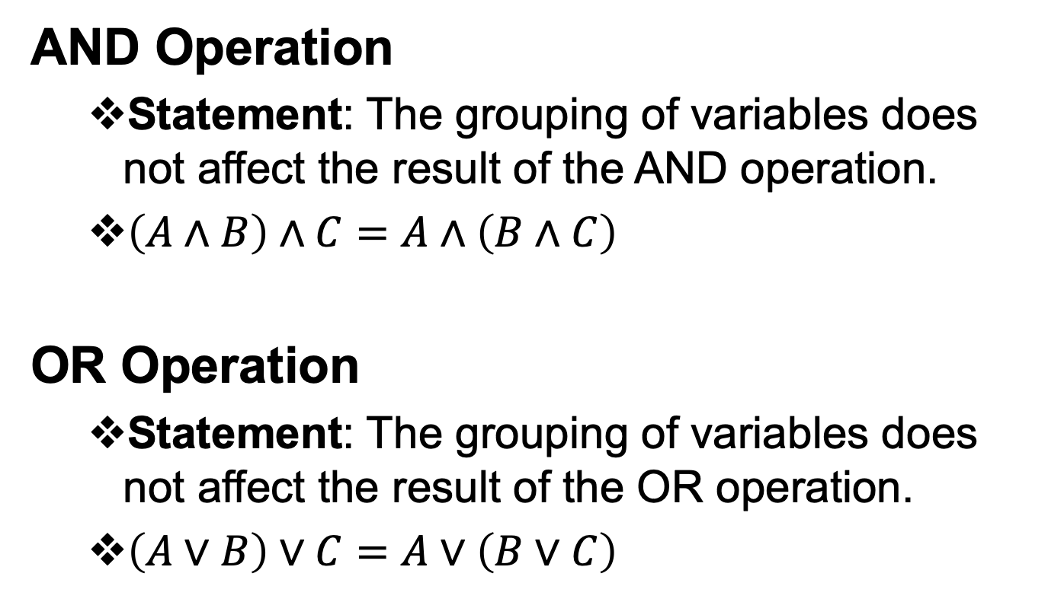
Associative Law
AND Operation
Statement: The grouping of variables does not affect the result of the AND operation.
$\left(A∧B\right)∧C=A∧\left(B∧C\right)$
OR Operation
Statement: The grouping of variables does not affect the result of the OR operation.
$\left(A∨B\right)∨C=A∨\left(B∨C\right)$

Slide 28
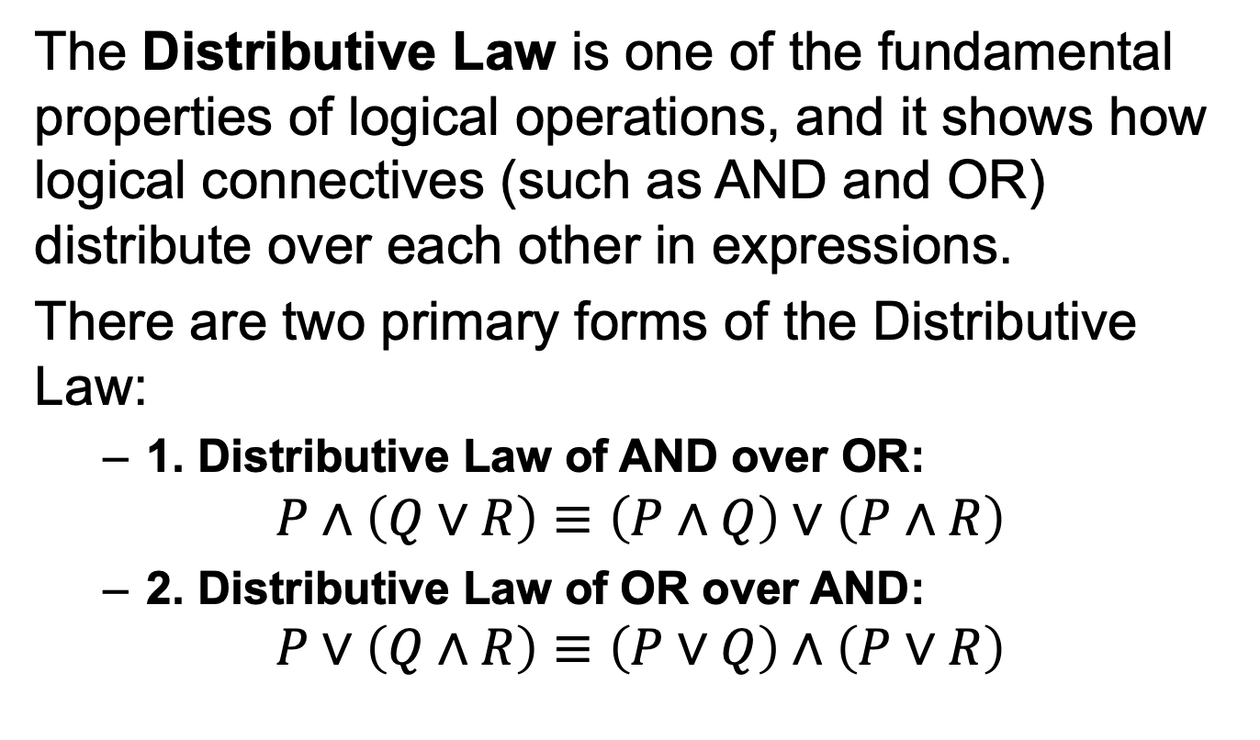
Distributive Law
The Distributive Law is one of the fundamental properties of logical operations, and it shows how logical connectives (such as AND and OR) distribute over each other in expressions.
There are two primary forms of the Distributive Law:
1. Distributive Law of AND over OR:
$$P∧\left(Q∨R\right)≡\left(P∧Q\right)∨\left(P∧R\right)$$
2. Distributive Law of OR over AND:
$$P∨\left(Q∧R\right)≡\left(P∨Q\right)∧\left(P∨R\right)$$

Slide 29
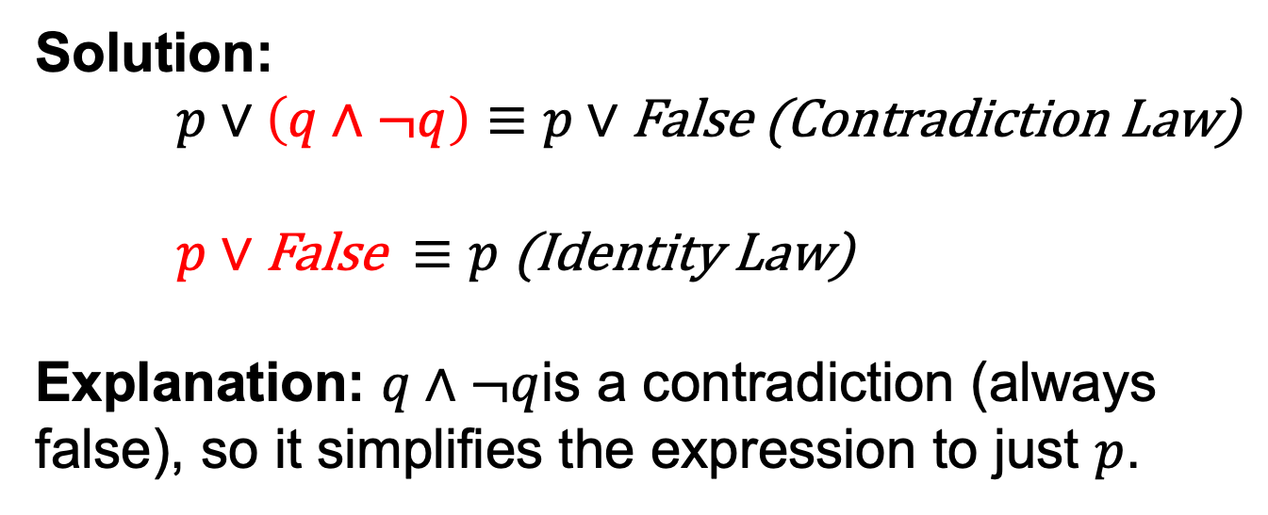
Simplify the following Expression
p∨(q∧¬q)
Solution:
$p∨\left(q∧¬q\right)≡p∨\text{False} \text{(}\text{Contradiction} \text{Law}\text{)}$
$p∨\text{False} ≡p \text{(}\text{Identity} \text{Law}\text{)}$
Explanation: $q∧¬q$is a contradiction (always false), so it simplifies the expression to just $p$.

Slide 30
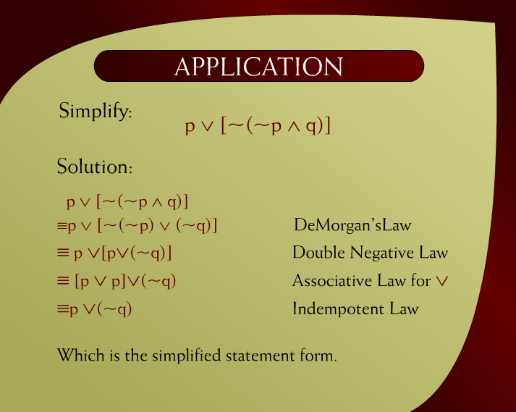
Application - 1

Slide 31
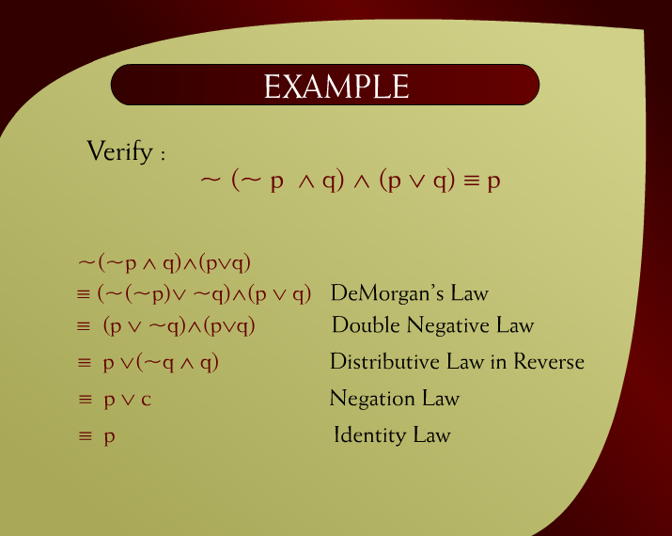
Example - 2

Slide 32
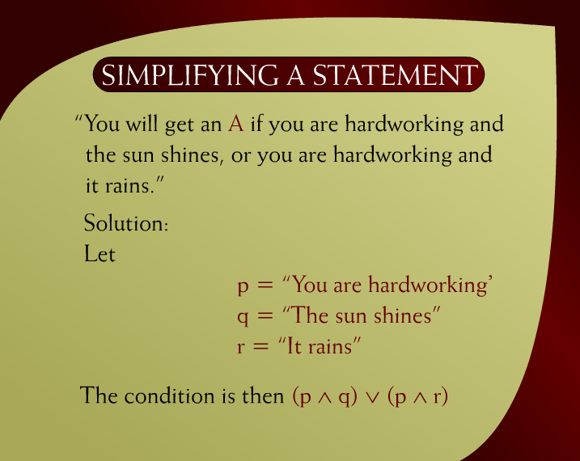
Simplifying a Statement – 3

Slide 33
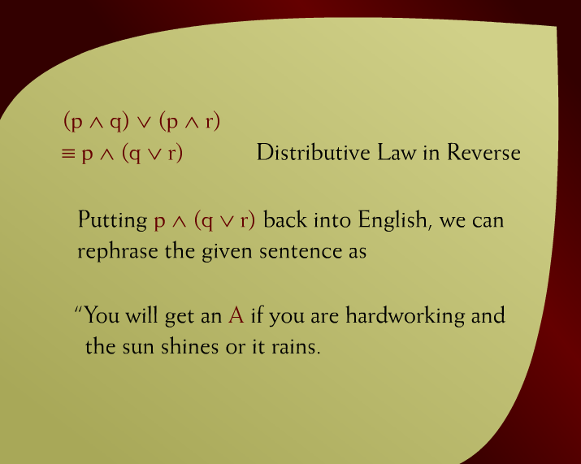
Distributive Law in Reverse – 4

Slide 34
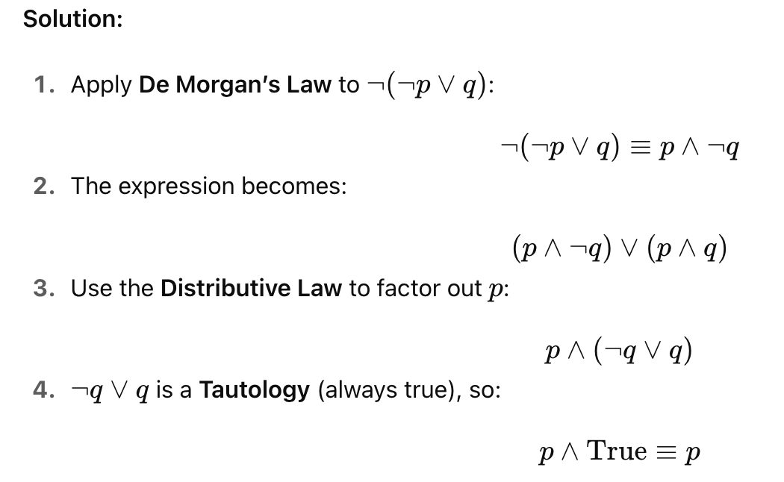
Verify ¬(¬p∨q)∨(p∧q)≡p

Slide 35
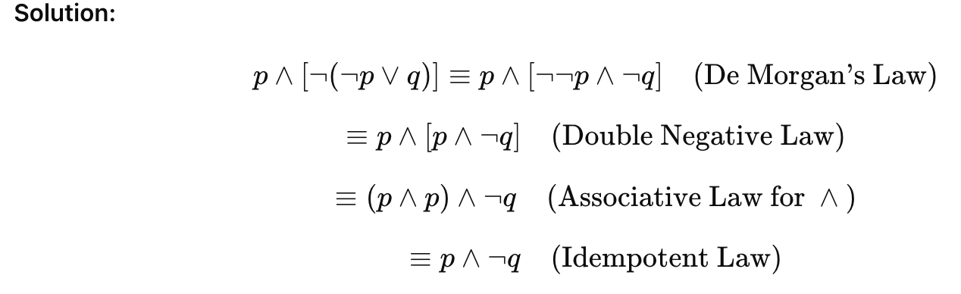
Simplify p∧[¬(¬p∨q)]

Slide 36
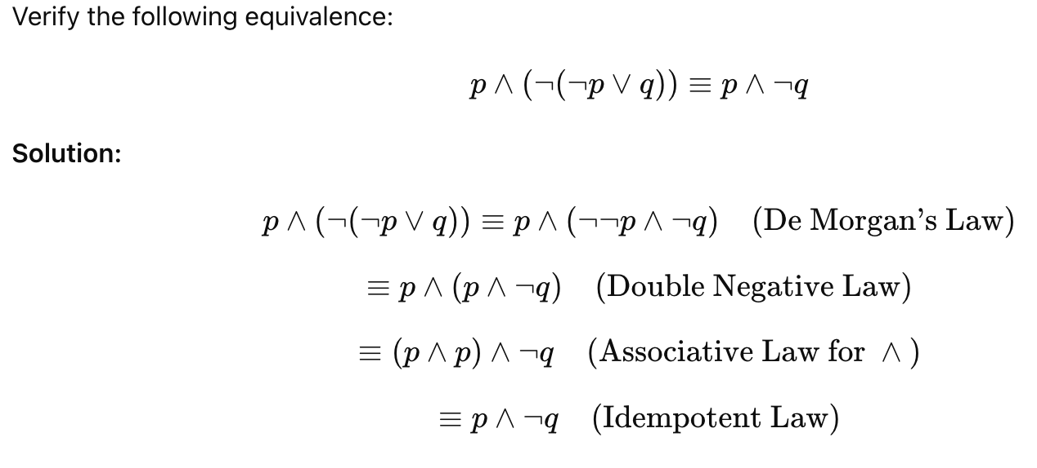
Verify p∧(¬(¬p∨q))≡p∧¬q

